Slide 1
Web Bazirani Merno-Akvizicioni Sistemi Revizija 4, izmene u 2021. na front end-u
Profesor: Prof. dr Platon Sovilj
Asistent: Stefan Mirković
Developer: Ivan Gutai

Slide 2
Ključne reči
JavaScript (ECMAScript 5 i ECMAScript 6)
HTML5 (Hyper Text Markup Language)
CSS3 (Cascading Style Sheets)
JSON (JavaScript Object Notation)
*C++ REST API (Representational state transfer application programming interface)
**Espressif ESP32 razvojna pločica + razni senzori
Wemos R1 D32 + Mikroe Arduino Uno click shield + Mikroe senzori
*https://github.com/fhessel/esp32_https_server
**https://www.espressif.com/en/products/socs/esp32

Slide 3
Alati
Microsoft Visual Studio Code
Google Chrome
Mozilla Firefox Developer Edition
Node.js (32-bit LTS verzija)
Arduino IDE

Slide 4
WEB interfejs merno-akvizicionog sistema

Slide 5
WBMAS solution (HTML osnova)

Slide 6
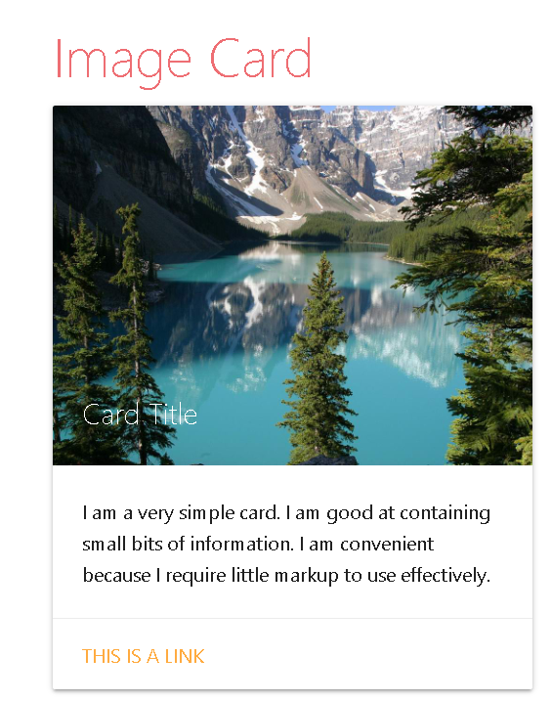
WBMAS solution (CSS osnova)
style.css fajl
Biblioteka *Materialize CSS (jedna od n)
* https://materializecss.com/

Slide 7
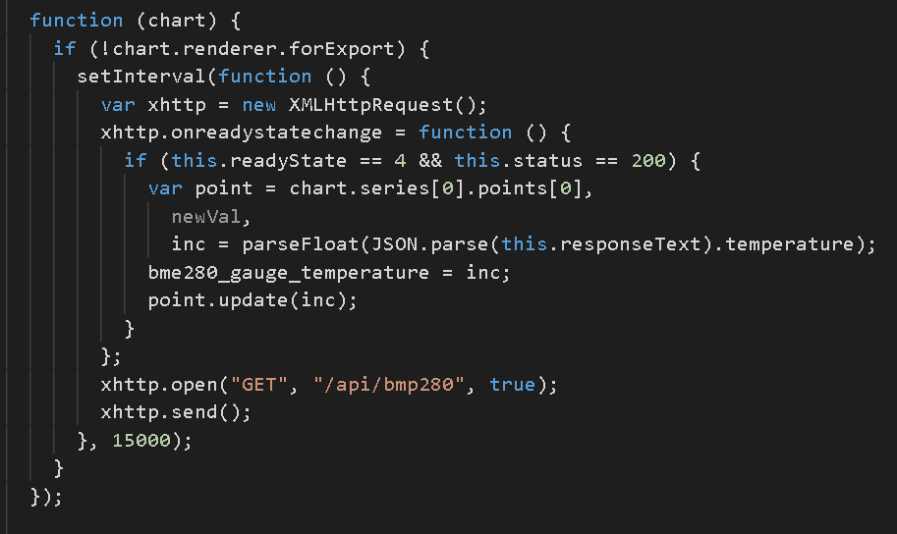
WBMAS solution (JS osnova)
util.js fajl
Biblioteka *jQuery
Biblioteka **Highcharts (jedna od n)
* https://jquery.com/
** https://www.highcharts.com/

Slide 8
praktičan primer

